Slide 1


DAYCARE
PROJECT
Object Oriented Design CSYE 6200 Group: 05

Slide 2




CONCEPTS AND TOOLS
5-Step Ordering Process
JAVA BACKEND
JAVA SWING FOR FRONTEND
FACTORY DESIGN PATTERN
MVC Architecture
DATABSE
IN CSV

Slide 3
Abhinav | Immunization functionality and frontend | Satvik | Classroom functionality and UML
Devansh | Teacher functionality and frontend | Tanmay | Student Functionality and UML
Kabir | Teacher functionality and documentation | Devanshu | Student and Classroom functionality
Gautham | Classroom functionality and documentation | Meet | Immunization functionality and Frontend
Rakesh |  | Rakesh | Frontend and Teacher functionality
CONTRIBUTIONS

Slide 4
TECHNOLOGY AND DESIGN CONCEPTS
GENERICS
RUNNABLE THREADS
FACTORY PATTERN DESIGN
LAMBDA FUNCTION
FUNCTIONAL PROGRAMMING
INHERITANCE
POLYMORPHISM
ABSTRACTION
ENCAPSULATION
STREAM API

Slide 5
LIBRARIES USED
JAVA SWING
JAVA UTIL
JAVA SIMPLE DATE FORMAT
JAVA AWT
JAVA UTIL CALENDER
JAVA TIME
JAVA.IO
JAVA NIO
THREADS
STREAM

Slide 6





FUNCTIONALITIES
TEACHER
IMMUNIZATION
TEACHER REGISTRATION
TEACHER REVIEW
VIEW TEACHER DETAILS
ANNUAL REVIEW ALERT
TRACK IMMUNIZATION
STORE RECORDS
UPDATE RECORDS
UPCOMING DATE
STUDENT
CLASSROOM
STUDENT REGISTRATION
STUDENT IMMUNIZATION STATUS
VIEW STUDENT DETAILS
REGISTRATION RENEWAL
UPDATE STUDENT IMMUNIZATION
STUDENT TEACHER MAPING
BASED ON STATE RULES

Slide 7
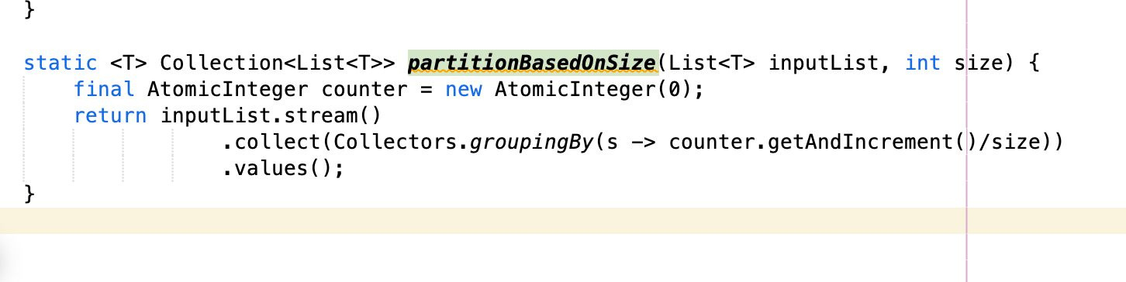
Generics

Slide 8
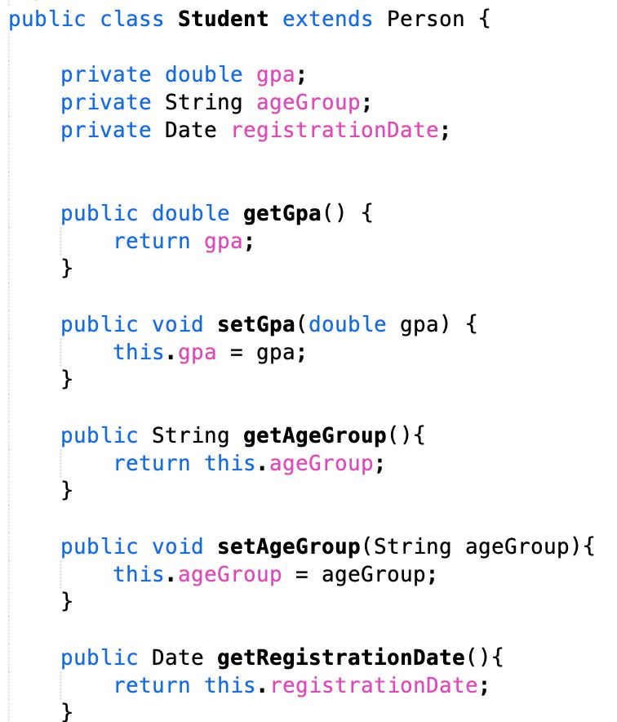
INHERITANCE

Slide 9
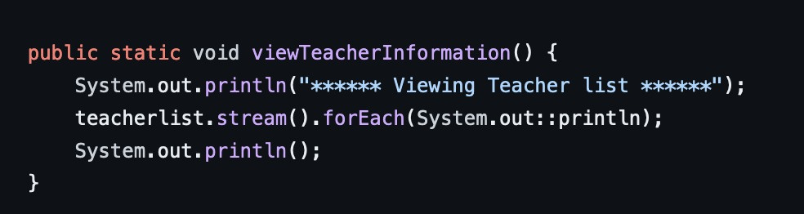
STREAM API

Slide 10
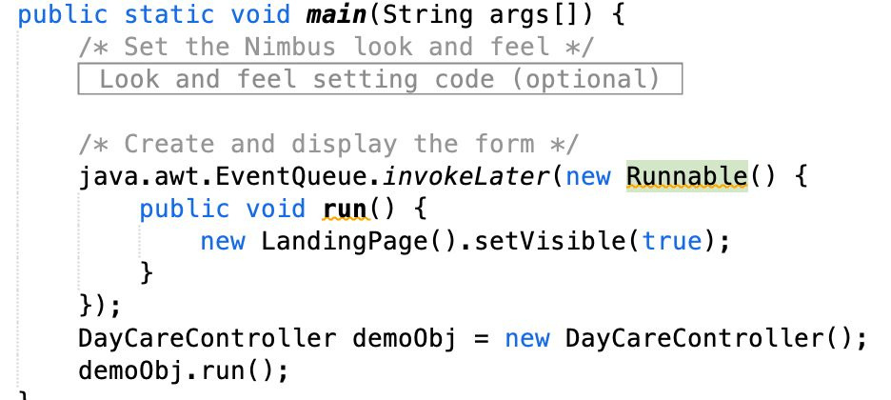
RUNNABLE THREAD

Slide 11
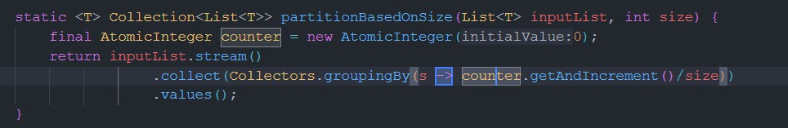
LAMBDA FUNCTION

Slide 12
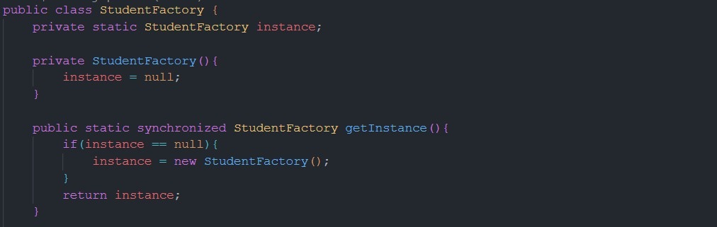
FACTORY DESIGN PATTERN

Slide 13
THANK YOU

